Slide 1


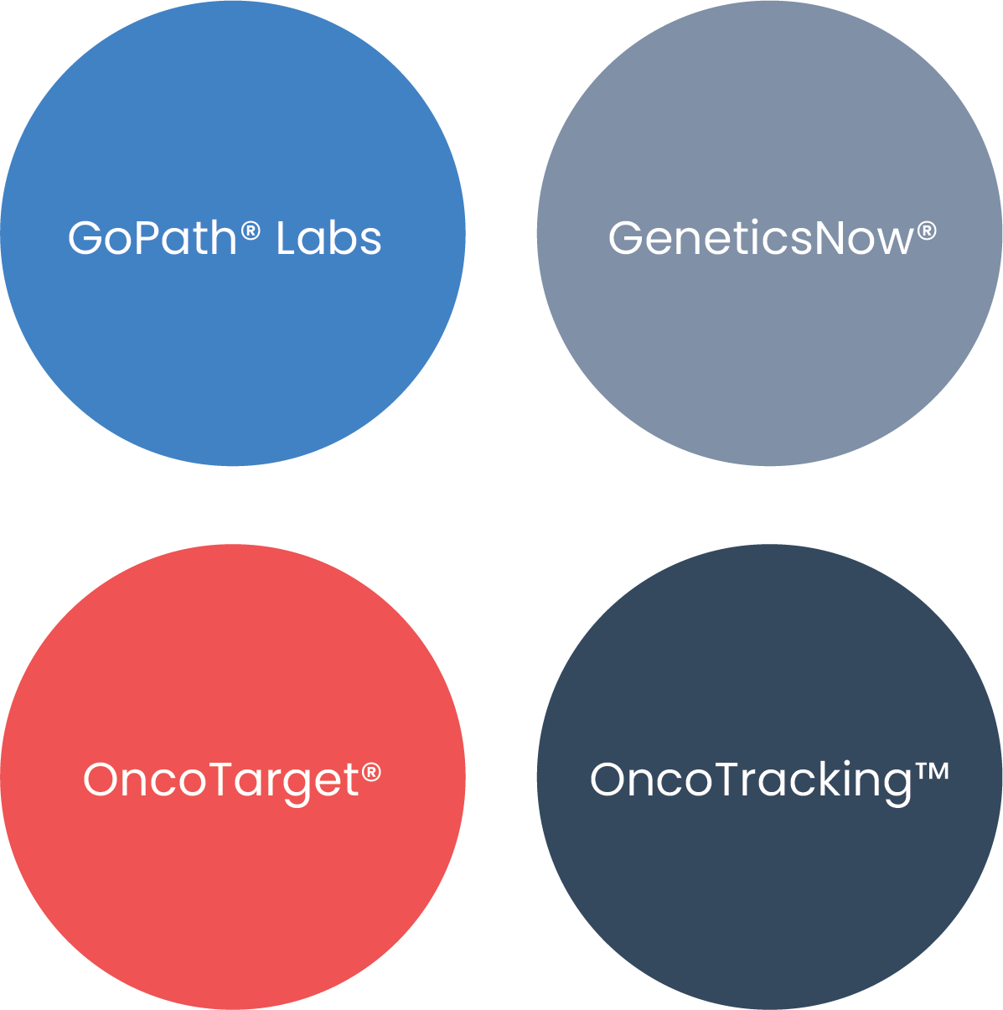
Endoscopy of North Shore – case review
(Breakdown by doctors)
Received cases: 2025Q1, GPIS LIS
Reported: Apr 17th, 2025

Slide 3
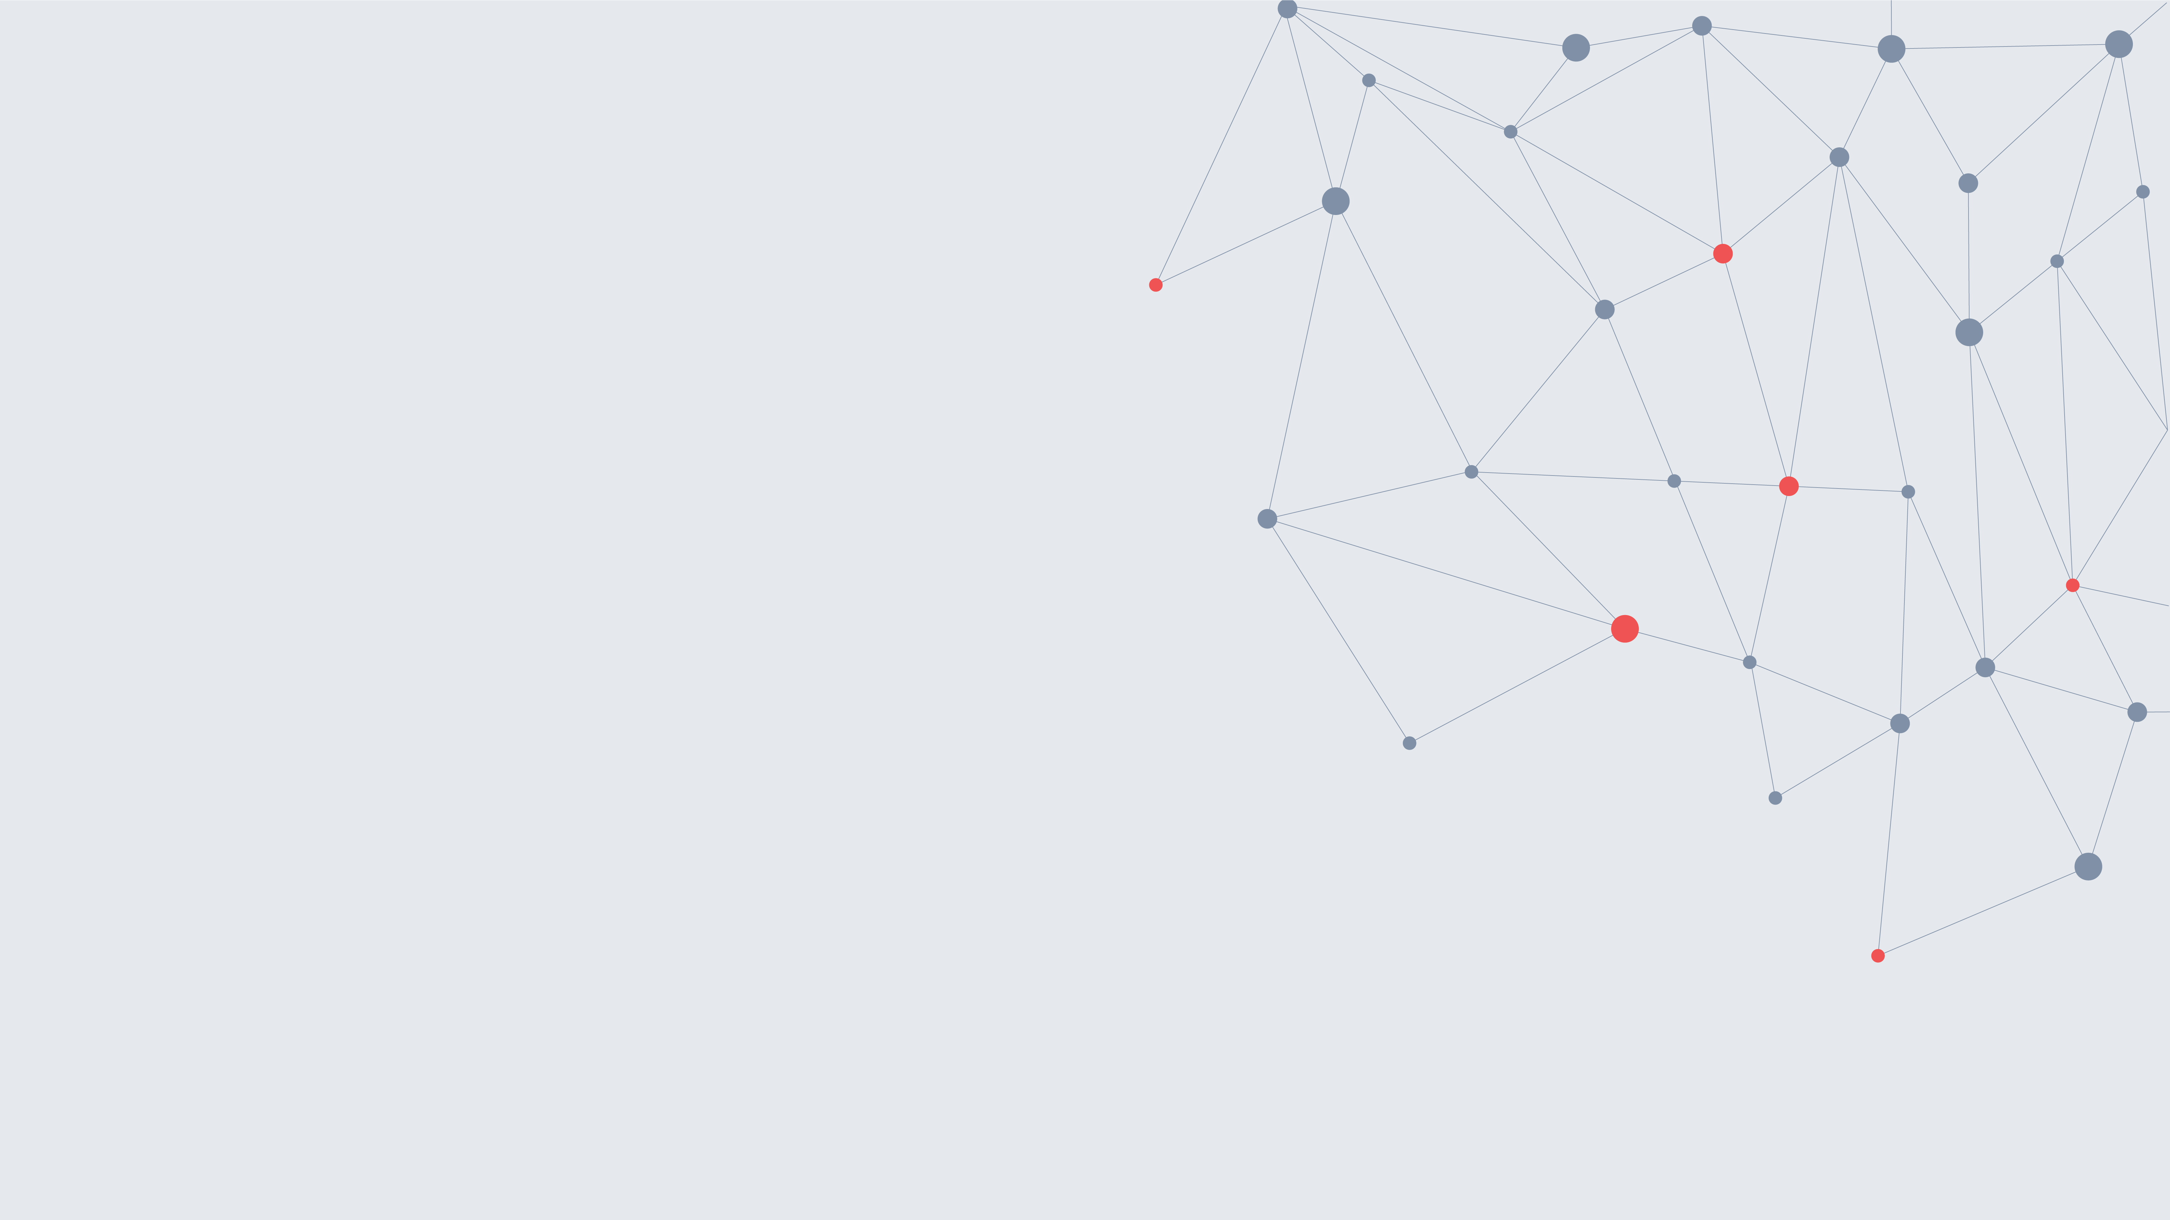

contact@gopathlabs.com ∙ 855-GOPATH9
www.gopathdx.com
1000 Corporate Grove Dr, Buffalo Grove, IL 60089

